Slide 1
Normalisation
Normalisation process – enables you to identify the existence of potential problems, called updating anomalies, in the design of a relational database
Normalisation is a process for assigning attributes to entities.
Aim
  to design good tables
  to minimise data redundancy and hence avoid problems with insert, update & delete

Slide 2
Normalisation
Normalisation works through a series of stages called normal forms:
  First normal form (1NF)
  Second normal form (2NF)
  Third normal form (3NF)
  Fourth normal form (4NF)
Normal form – possesses a certain desirable collection of properties

Slide 3
Normalisation
Starts with a heap of data - usually some form of required output e.g. a report
Put it all into one table
  draw a dependency diagram
  apply the normalisation rules
  create new tables as required

Slide 4
Normalisation
1NF (First Normal Form)
  no repeating groups
  Primary Key defined
  single valued attributes
2NF (Second Normal Form)
  1NF
  no partial dependencies
3NF (Third Normal Form)
  2NF
  no transitive dependencies

Slide 5
Dependency Diagram
What is a Determinant?
  StudentID => StudentName
  StudentID determines StudentName
  StudentID is a Determinant
StudentName depends on StudentID
There is a Dependency between StudentName and StudentID

Slide 6
Partial dependency
an attribute is dependent on PART of the key

Slide 7
Transitive dependency
an attribute is dependent on a NON-KEY attribute

Slide 8
The Need for Normalisation
Case of a Software Development Company
  Software project - Project number, Name, Employees assigned to the project.
  Employee - Employee number, Name, Job classification
  The company charges its clients by billing the hours spent on each project. The hourly billing rate is dependent on the employee’s position.
  Periodically, a report is generated.

Slide 9
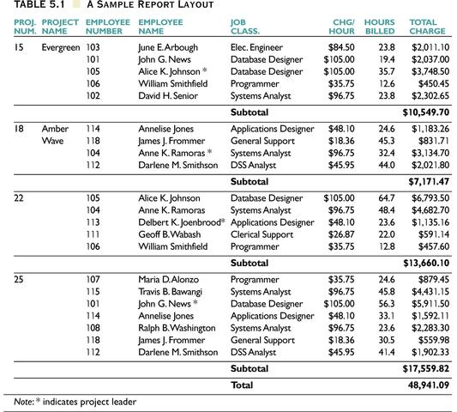

Slide 10
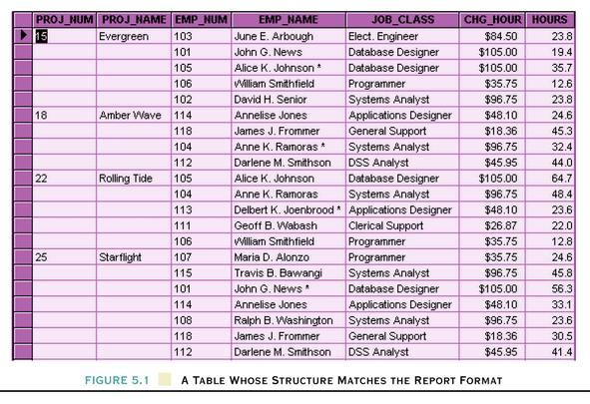
A Table Whose Structure Matches the Report Format

Slide 11
Problems with the Figure 5.1
The project number is intended to be a primary key, but it contains nulls.
The table displays data redundancies.
The table entries invite data inconsistencies.
The data redundancies yield the following anomalies:
  Update anomalies.
  Addition anomalies.
  Deletion anomalies.

Slide 12
Update Anomalies
Update
  Information is in multiple rows, difficult to update
Inconsistent data
  Because of the duplication, a row that is not updated causes inconsistency
Additions
  Dummy records are required to add new unused dependent rows
Deletions
  Risk deleting other data

Slide 13
Conversion to First Normal Form
A relational table must not contain repeating groups.
Repeating groups can be eliminated by adding the appropriate entry in at least the primary key column(s).

Slide 14
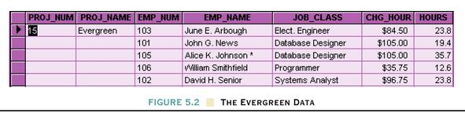
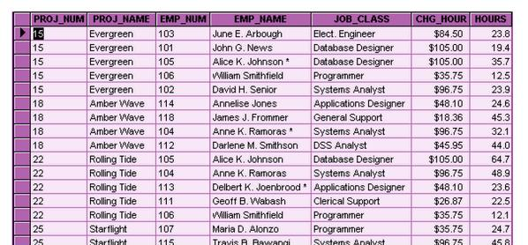
First Normal Form

Slide 15
1NF Definition
The term first normal form (1NF) describes the tabular format in which:
  All the key attributes are defined.
  There are no repeating groups in the table.
  All attributes are dependent on the primary key.
  There are no multi-valued attributes

Slide 16
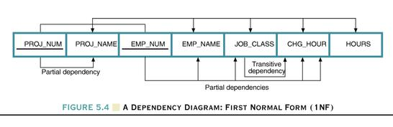
Dependency Diagram
The primary key components are bold, underlined, and shaded in a different color.
The arrows above entities indicate all desirable dependencies, ie, dependencies that are based on PK.
The arrows below the dependency diagram indicate less desirable dependencies - partial dependencies and transitive dependencies.

Slide 17
2NF Definition
A table is in 2NF if:
  It is in 1NF and
  It includes no partial dependencies; that is, no attribute is dependent on only a portion of the primary key.
  (It is still possible for a table in 2NF to exhibit transitive dependency; that is, one or more attributes may be functionally dependent on nonkey attributes.)

Slide 18
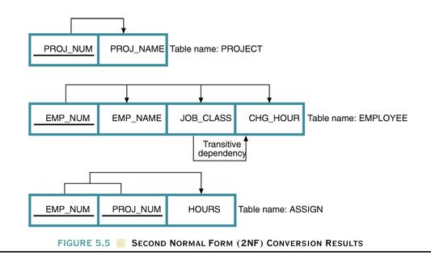
Second Normal Form (2NF) Conversion Results

Slide 19
3NF Definition
A table is in 3NF if:
  It is in 2NF and
  It contains no transitive dependencies.

Slide 20
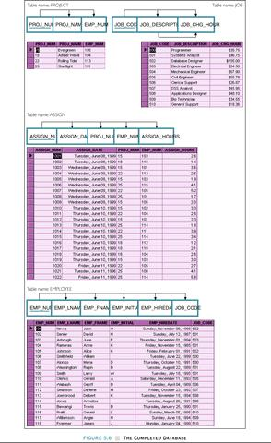

Slide 21
Unnormalised Record
Order Num | Order Date | Cust Num | Cust Name | Cust Address | Prod Num | Prod Name | Qty Ordered | Prod Price | Prod Total | Order Total
0101 | 1/9/04 | C21 | Bloggs | …. | 56 | Pen | 3 | $2.30 | $6.90 | $19.90
 |  |  |  | …. | 59 | Pencil | 5 | $1.20 | $6.00 | $19.90
 |  |  |  | …. | 48 | Ruler | 2 | $3.50 | $7.00 | $19.90
0102 | 2/9/04 | C22 | Jones | …. | 59 | Pencil | 1 | $1.20 | $1.20 | $1.20
 |  |  |  | …. | 56 | Pen | 2 | $2.30 | $6.40 | $6.40

Slide 22
First Normal Form (1NF)
Order Num | Order Date | Cust Num | Cust Name | Cust Address | Prod Num | Prod Name | Qty Ordered | Prod Price | Prod Total | Order Total
0101 | 1/9/04 | C21 | Bloggs | …. | 56 | Pen | 3 | $2.30 | $6.90 | $19.90
0101 | 1/9/04 | C21 | Bloggs | …. | 59 | Pencil | 5 | $1.20 | $6.00 | $19.90
0101 | 1/9/04 | C21 | Bloggs | …. | 48 | Ruler | 2 | $3.50 | $7.00 | $19.90
0102 | 2/9/04 | C22 | Jones | …. | 59 | Pencil | 1 | $1.20 | $1.20 | $1.20
0102 | 2/9/04 | C22 | Jones | …. | 56 | Pen | 2 | $2.30 | $6.40 | $6.40

Slide 23
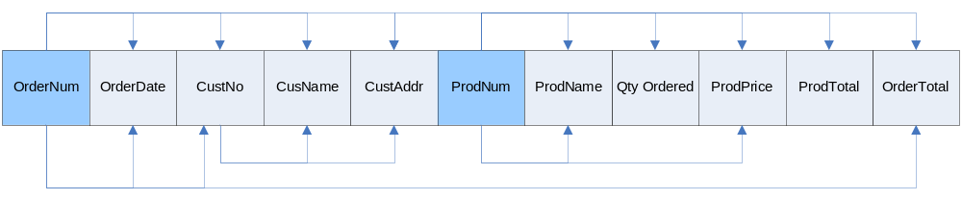
Dependency Diagram

Slide 24
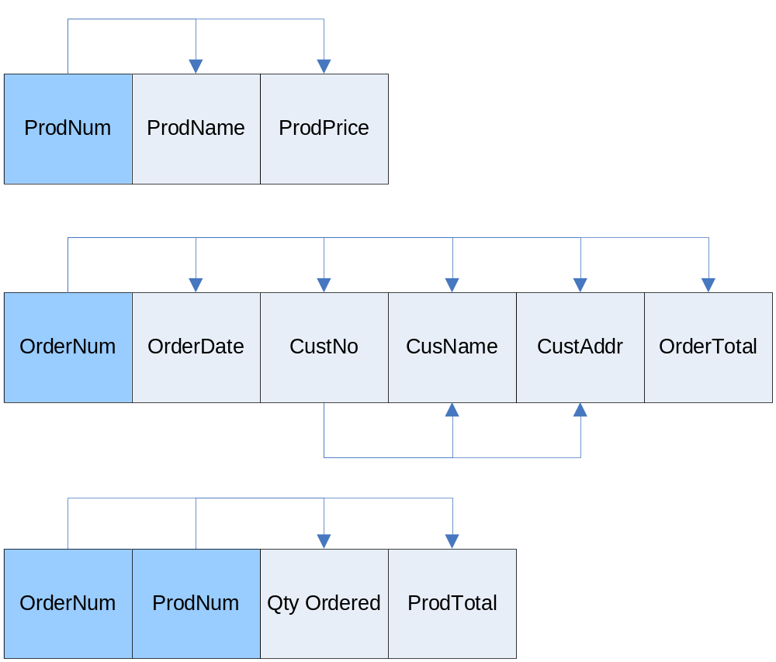
Second Normal Form (2NF)
Obtained by removing attributes which are dependent on part of the primary key.

Slide 25
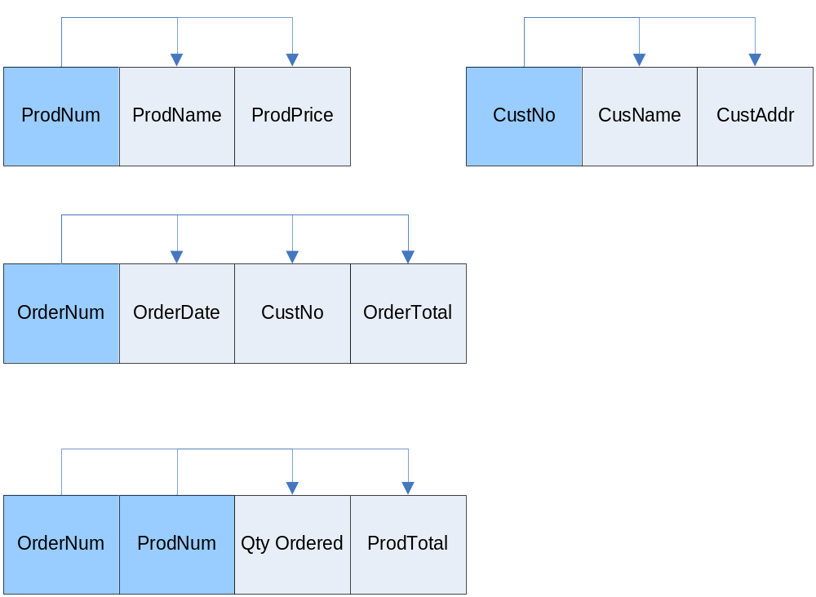
Third Normal Form (3NF)
Obtained by removing attributes which are dependent on a non-key attribute.

